Slide 1

Topic: Pollination adaptations

Slide 2
Pollination is the process of transfer of pollen grains from anther and their deposition on the stigma of a flower.
Pollination is of 2 types:
Self pollination
Cross pollination

Slide 3
Self pollination
Involves the transfer of pollen grains from the anthers to the stigma of the same flower or of another flower borne by the same plant.
It is of two types :
Autogamy
  Pollen from the anthers of a flower are transferred to the stigma of the same flower.
Geitonogamy
  Pollen from the anthers of one flower are transferred to the stigma of another flower borne on the same plant.
  Involves two flowers belonging to the same parent plant.
  Usually occurs with monoecious condition.

Slide 4
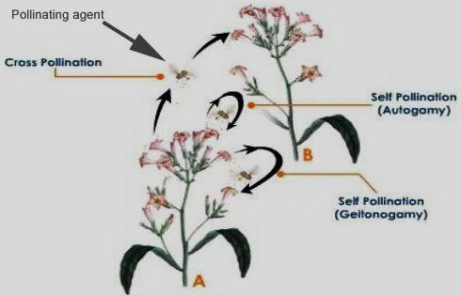
Different forms of self pollination: Autogamy and Geitonogamy

Slide 5
Merits
Pollen grains are not wasted.
The purity of the generation is maintained.
Demerits
New and healthier varieties are not formed.
Results in weak progenies, producing weaker seeds and plants.

Slide 6
Pollination
Self pollination Cross pollination
(Xenogamy)
Autogamy Geitonogamy
(same flower)
(different flowers of the same plant)

Slide 7
Self pollination
It is the transfer of pollen grains from anthers to the stigma of the same plant.
Autogamy: It is the transfer of pollen grains from anthers to the stigma of the same flower.
Autogamy in flowers requires synchrony in pollen release and stigma receptivity. Also anthers and stigma should lie close to each other.
In some plants such as Viola, Oxalis and Commelina,2 types of flowers are produced

Slide 8
Contrivances for self pollination

Slide 9
Contrivances for self pollination
Bisexuality
  Flowers should be bisexual or hermaphrodite.
Homogamy
  Anthers and stigma of the bisexual flowers mature at the same time.
  They are brought close to each other by growth, bending or folding to ensure self pollination.
  This condition is called homogamy.
    Mirabilis (Four O, clock)
    Catharanthus
    Potato
    Sunflower
    Wheat

Slide 10
(c) Cleistogamy
Some plants never open to ensure complete self-pollination.
Examples:
  Commelina bengalensis
  Oxalis
  Viola
Cleistogamous flowers are:
  bisexual small
  Inconspicuous
  colourless
  do not secrete nectar

Slide 11
Chasmogamous flower(open flower)have exposed anthers and stigma.
Cleistogamous flower:These flowers donot open and their anther and stigma lie close to each other. Cleistogamous flower are invariably autogamous as there is no chance of cross-pollination. Such flowers assures seed set even in the absence of pollinators.

Slide 12
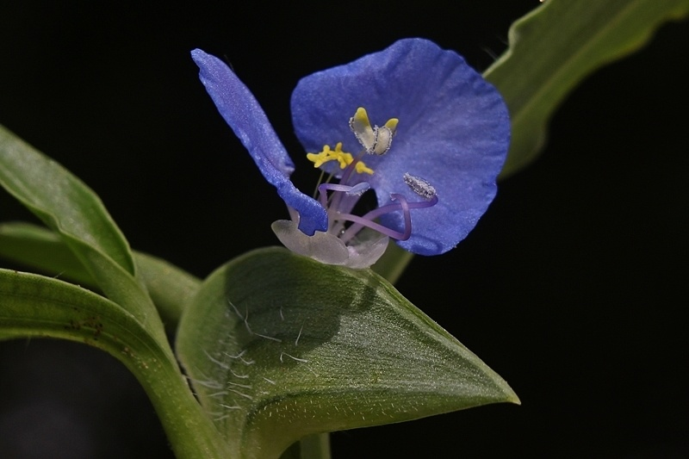
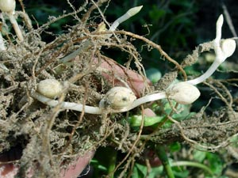
Commelina
Chasmogamous flower Cleistogamous flower

Slide 13
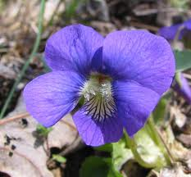
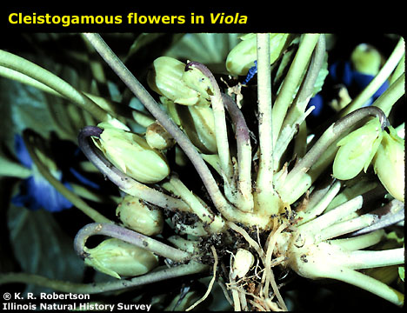
Viola
Chasmogamous flower Cleistogamous flower

Slide 14
Advantages of self pollination
It is a sure and economical method of pollination.
Self pollination is used to maintain pure lines.
Plants need not to produce large numbers of pollen grains.

Slide 15
Cross pollination

Slide 16
Cross pollination (Xenogamy)
Involves the transfer of pollen grains from the flower of one plant to the stigma of the flower of another plant.
Merits
Seeds are more and viable.
Progenies are healthier.
Adaptability is better.
New varieties can be produced.
Demerits
The process is not definite because plants depend on
external agencies.
Large amount of pollen grains are wasted.

Slide 17
Contrivances for cross pollination

Slide 18
Contrivances for cross pollination
Nature favours cross pollination.
All unisexual flowers and a large number of bisexual flowers are naturally cross pollinated.
The main contrivances ensuring cross pollination are as follows:
(i) Diclincy or Unisexuality: In unisexual flowers stamens and carpels are found in different flowers.
Unisexuality can be of two types:
Monoecious plant : When male and female flowers are borne on the same plant. e.g., Maize, Cucurbits, Castor.
Dioecious plant : When male and female flowers are borne on different plants. e.g., Carica papaya, Cannabis.

Slide 19
Dichogamy
  In bisexual flowers, when two sexes mature at different intervals and thus avoid self pollination is known as dichogamy.
Protandry
  When stamens mature earlier than the stigma.
Examples:
    Coriander
    Jasmine
    Sunflower
    Lady’s finger
Protogyny
  When stigma matures earlier than the stamens. Examples:
    Rose
    Tobacco
    Crucifers

Slide 20
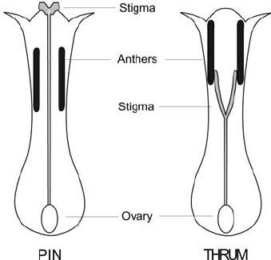
Heterostyly
  Flowers are dimorphic.
  Pin-eyed: long style but short stamens.
  Thrum-eyed: short style and long stamens.
  Example: Oxalis.
Heterostyly

Slide 21
(iv) Herkogamy
Stigma and anthers mature at the same time.
Self pollination is avoided by some sort of barrier.
The flowers show following contrivances :
  The male and female sex organs lie at some distance
from each other.
  In some flowers corolla has peculiar forms which act as barrier in self pollination. e.g., Aristolochia.
  In some other flowers, the pollens are held together to form pollinia which can only be carried away by insects.
Example: Orchids and Calotropis.

Slide 22
Self sterility or Incompatibility
  Pollen grain of an anther do not germinate on the stigma of the same flower.
  Such flower is called self sterile or incompatible and this condition of flower is called self sterility.
  Also termed as intraspecific incompatibility or self incompatibility.
  In these flowers cross pollination is the only means for
fertilization and production of seeds.

Slide 23

Agents for cross pollination

Slide 24
Agents for cross pollination
There are two main groups of agents:
Abiotic
  Wind
  Water
Biotic
  Insects
  Birds
  Bats
  Snails

Slide 25
Cross-pollination
It is the transfer of pollen grains from anthers to the stigma of different plant.
Also known as xenogamy.
Cross pollination can occur only with the help of external agents called pollinating agents(abiotic and biotic)
Abiotic agents are water and wind.
Biotic agents include insects, bat, birds,etc.
Types of pollination are named after their pollinating agents.eg anemophily,hydrophily, entomophily etc.

Slide 26
Biotic agents
Entomophily
  Pollination brought about by insects.
  Moths, beetles, butterflies, wasp, etc.
  Flowers: brightly coloured, sweet smell, nectar.
  Flowers produce a small amount of pollen which has a spinous and sticky exine.
  The stigmas of such flowers are long rough and sticky.
Examples:
  Salvia: Lever or turn pipe mechanism
  Yucca (by Tageticula moth),
  Orchid Ophrys speculum (by Colpa aurea, a hairy wasp),
  Ficus (by Blastophega)

Slide 27
ENTOMOPHILY
Entomophily: It is the transfer of pollen grains from anthers of one flower to the stigma of another flower with the help of moths, bees, wasp, butterflies, beetles, ants, flies etc.
Insect visit the flower for obtaining pollen, nectar or shelter.
Some insects use flower for laying eggs. E.g. Amorphophallus(it has largest inflorescence and the tallest flower)

Slide 28
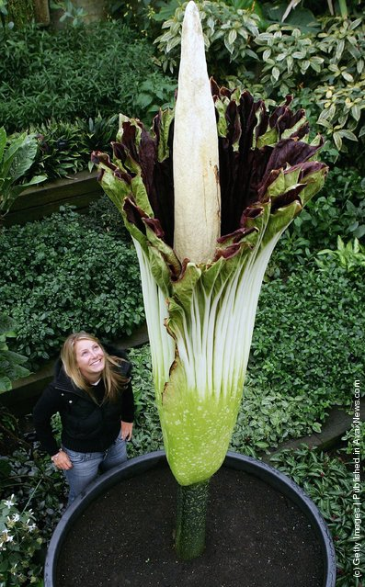
Amorphophallus

Slide 29
While picking up food insects deposits pollen grains brought from another flower over the stigma and get dusted afresh with pollen grains from the present flower.
However all insects visitors are not pollinators. Some of them visit the flowers only for pollen and nectar, they are called pollen/nectar robbers.

Slide 30
Characteristic of entomophilus flowers
Flowers are coloured for attracting the insects. Moths are attracted towards white colour, reddish colour attract butterflies, honey bees are attracted towards bluish-purplish-violet-yellow flowers.
Both petals & sepals are well-developed.
Petals are usually coloured. Where petals are not showy other flower parts becomes conspicuous
Eg. Coloured bracts in Bougainvillea

Slide 31
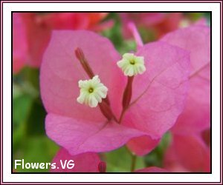
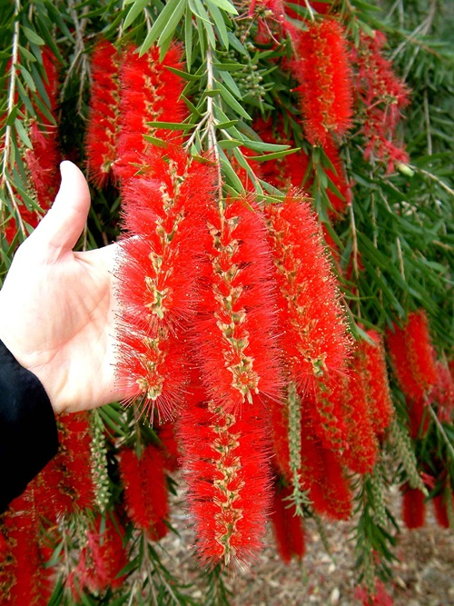
Coloured bract of Bougainvillea
Stamens in
Callistemon

Slide 32
Stamens in Callistemon, Acacia
Flowers are generally large in size so that they become conspicuous from a distance.
Flowers generally produces odour which can be pleasant in jasmine, rose or foul as in Rafflesia
Foul odour attracts flies for pollination
Special markings are present on petals to guide the insects to the nectar. These are called nectar or honey guide.

Slide 33
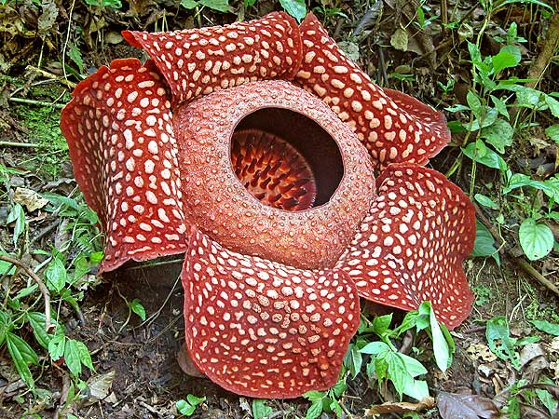
Rafflesia(produces rotten meat like smell)

Slide 34
Pollen grains are covered by a yellow sticky substance called pollenkitt.
Normally are inserted.
Stigma is inserted and sticky.

Slide 35
(b) Ornithophily
Pollinated by birds.
Common bird pollinators: Sun bird, Humming bird, Crow,
Bulbul, Parrot, Mynah, etc.
Examples: Bombax (red silk cotton), Erythrina (Coral tree),
Callistemon (Bottle brush), Bignonia, Agave, etc.
Flowers: brightly coloured; plenty of nectar; large quantities
of pollen.
Humming bird pollinates while hovering over the flowers and sucking nectar.
The bird can derive about half of its body weight of nectar in a single day.
The nectar is chiefly made of sugars and provides a sweet drink to the bird.

Slide 36
ornithophily
Cross pollination performed through birds.
Pollinating birds generally have long beaks,Iarger than the length of corolla tube.
E.g.. Sun bird & Humming bird
Flowers are large sized.
Brightly coloured.
Odor is generally absent.
Floral parts are strong & leathery.
Flower secretes a lot of nectar.

Slide 37
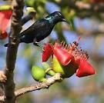
SUN BIRD ON Bombax
E.g. Butea monosperma, Agave, Bombax

Slide 38
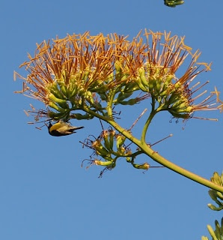
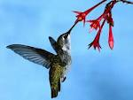
Humming bird on Agave

Slide 39
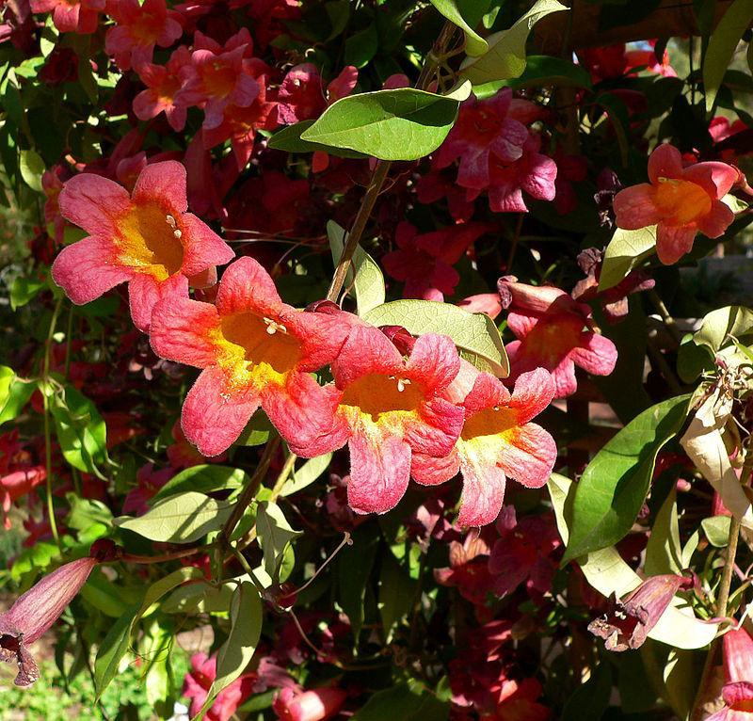
Bignonia (Image courtesy: Wikipedia)

Slide 40
(c) Chiropterophily
Pollination performed by bats.
Flowers: large, dull-coloured, have a strong scent.
Chiropterophilous flowers produce abundant pollen grains.
Flowers secrete more nectar than ornithophilous flowers and open at night emit a good fragrance.
Examples:
  Kigelia pinnata (Sausage tree)
  Adansonia (Baobab tree)
  Bauhinia megalandra
  Anthocephalus (Kadamb tree)

Slide 41
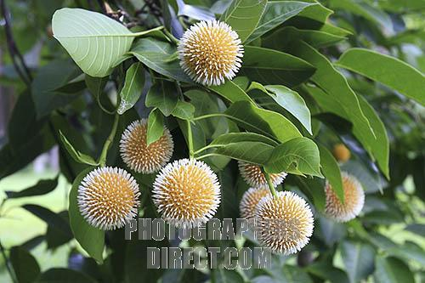
Cheiropterophily
Cross pollination performed through bats.
Bats perform pollination during night
They visit the flower for nectar
Eg. Kigelia pinnata, Anthocephalus, Adansonia

Slide 42
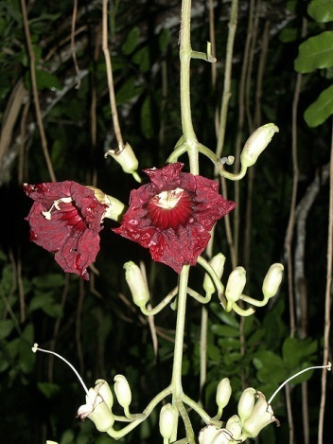
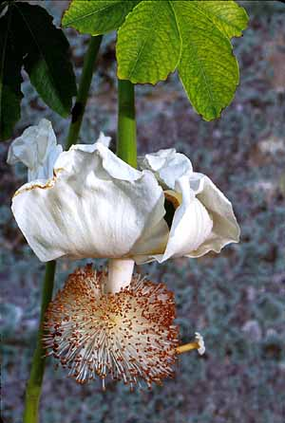
Kigelia pinnata Adansonia

Slide 43
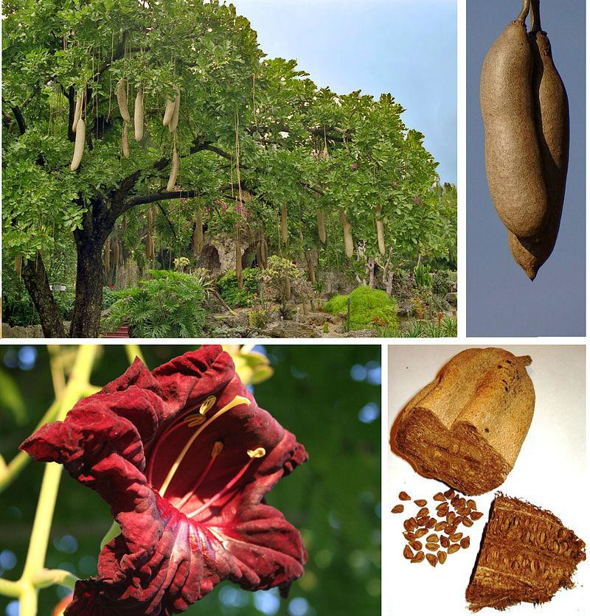
Kigelia (Image courtesy: Wikipedia)

Slide 44
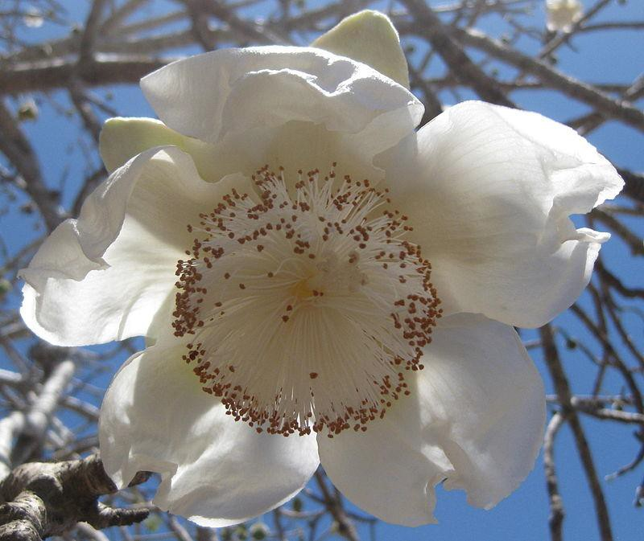
Adansonia (Image courtesy: Wikipedia)

Slide 45
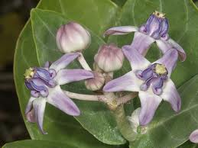
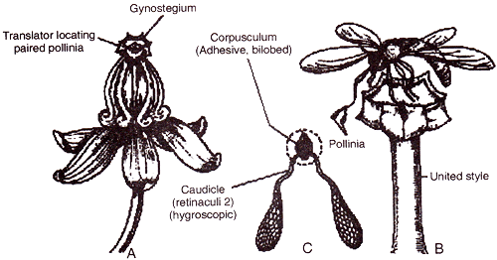
ENTOMOPHILOUS SPECIALIZATION
Calotropis: In Calotropis, pollen grains occur in sacs called pollinia.Two adjacent pollinia are attached to a common sticky corpusculum to form a translator.These translator can be lifted by insects only.

Slide 46
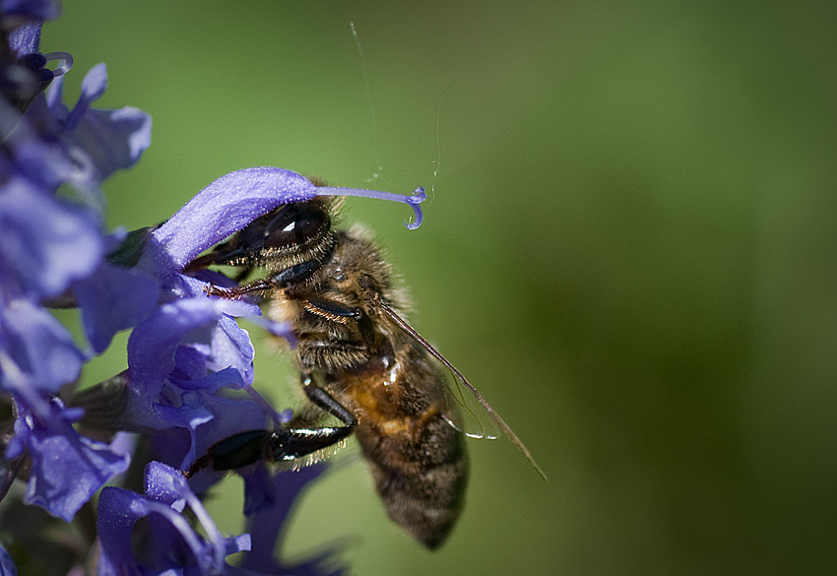
Salvia: It has a lever mechanism for pollination by insects. Flower is protandrous with 2 functionl stamens. Corolla is bilipped.The lower lip act as a platform for visiting insects. Upper lip encloses essential organs. Each stamen bears long connective with fertile anther lobe at one end and flat sterile anther lobe at

Slide 47
Other end.
Flower possess nectar at the base of the ovary.
When an insect visits young flower, the plate like sterile anther lobe is pushed inwardly while the fertile anther lobe strikes the back of insect to throw pollen there.
In old flowers the stamens wither. The style elongates & bend the mature stigma to pick pollen grains from the back of the insect.

Slide 48
Abiotic agents
Anemophily
  Pollinated by wind.
  Flowers are:
    small and inconspicuous
    with long and versatile stamens.
  Examples:
    Sugarcane
    Maize
    Wheat
    Bamboo
    Pinus
    Papaya
    Grasses
    Mulberry
    Chenopodium

Slide 49
anemophily
(Gk.anemos-wind, philein-to love)It is a mode of cross pollination performed through the agency of wind.
Anemophily is most common of the 2 abiotic pollinations.
Air currents pick up pollen grains from the dehiscing anthers and carry the same to different places. Receptive stigma pick up the pollen floating in the air.

Slide 50
Characters of anemophilous flowers
Flowers are small & inconspicuous. They are packed in inflorescence.
Non-essential floral parts are absent or reduced.
Flowers are usually colourless, nectar less, odourless.
Flowers are developed above the foliage, usually in hanging spikes or catkins.
Anthers are exerted and versatile.
Anthers burst forcefully & suddenly to throw the pollens in air as in Urtica. It is gun powder mechanism.

Slide 51
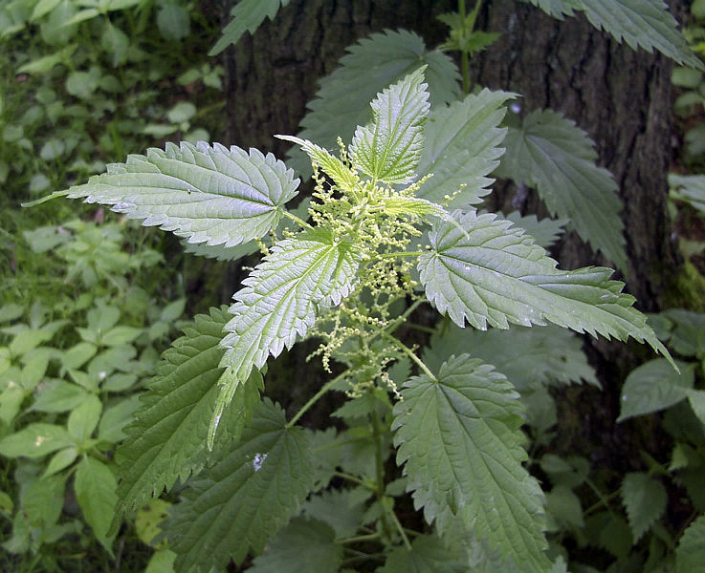
Urtica

Slide 52
Pollen grains are small, smooth, non-sticky & light. They may have air sacs or wings so that they can float in air for long distances.
Very large number of pollen grains are produced.eg.500000 per flower in cannabis, 135 million by Mercurialis,25 million by a tassel of maize.
Pollen grains are dry and wet.
Stigma are exerted ,hairy, feathery or branched to capture the pollen grains
Anemophily is common in grasses.

Slide 53
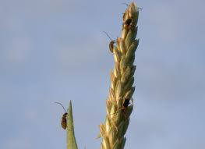
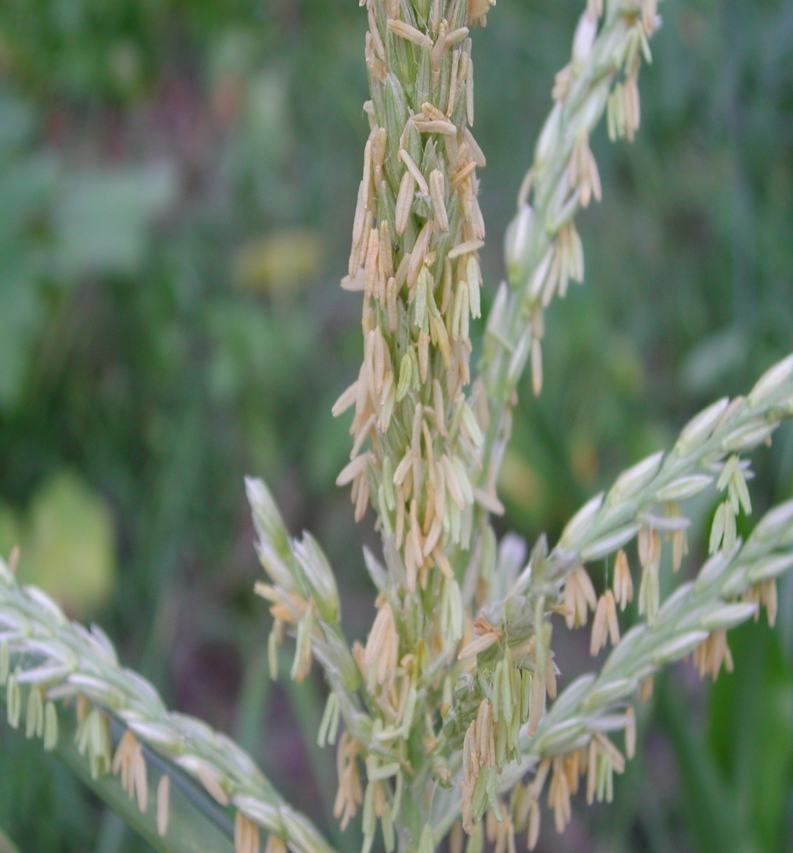
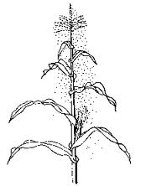
Tassel of maize

Slide 54
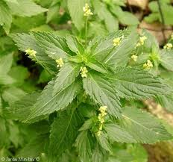
Mercuralis

Slide 55
(b) Hydrophily
Pollination takes place through water.
All aquatic plants are not hydrophilous.
Hydrophily is of two types:
  Hypohydrophily
    Plants which are pollinated inside the water.
    Examples:
      Zostera
      Ceratophyllum
      Najas
  Epihydrophily
    Plants which are pollinated outside the water.
    Examples:
      Vallisneria (Ribbon weed)

Slide 56
Hydrophily
(Gk.hydro-water; philein-to love)pollination brought through the agency of water.
It occurs in about 30 genera of mostly monocotyledonous aquatic plant.eg. Vallisneria,Ceratophyllum,Zostera.

Slide 57
Flowers are small ,inconspicuous and light.
Perianth is not wettable.
Flowers are without nectar and odour.
Pollen grains are surrounded by mucilaginous covering.
Hydrophily is of 2 types-
Hypohydrophily:Pollination takes place below the surface of water.eg Ceratophyllum, Zostera

Slide 58
Zostera (sea grass)it is a marine angiosperm. pollen grains are long and ribbon shaped.Pollen grains float below the surface of water.
Epihydrophily: pollination takes on the surface of water.eg Lemna,Vallisneria
Vallisneria(ele grass)it is submerged ,dioecious fresh water plant
Each male flower has 2 stamens,2 tepals forming a boat like structure while the third small tepal upwardly bent tepal forms the sail.

Slide 59
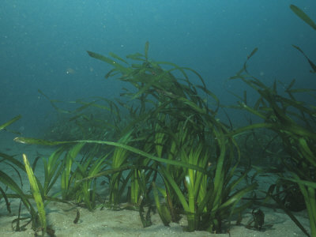
Zostera

Slide 60
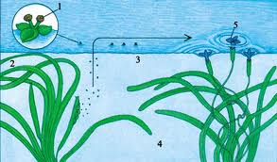
Vallisnera

Slide 61
Female plant produces female flowers at the tip of long pedicels that brings the flowers on the surface of water.
During floating male flowers are drawn in the depression of female flower. Anthers of open male flowers come in contact with large trifid stigma of female flower for pollination.
After pollination, female flower closes again. It is brought down into water by coiling of stalk.

Slide 62
(d) Malacophily
Pollination by slugs and snails.
Land plants like Chrysanthemum and water plant like Lemna
shows malacophily.
Myrmecophily
  Pollination by ants.
  Example: Anemone nemarosa.

Slide 63
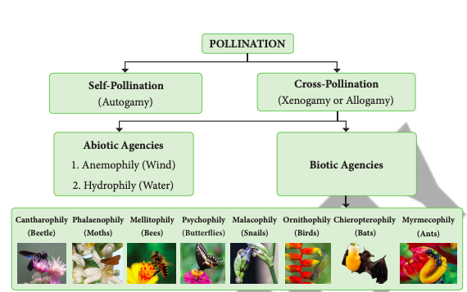

Slide 64
recapitulation
Pollination
Self pollination Cross pollination
(Xenogamy)
Autogamy Geitonogamy
(same flower)
(different flowers of the same plant)

Slide 65
Pollinating agents
Abiotic Biotic
Wind(Anemophily)
Water(Hydrophily) Insect(Entomophily)
Birds(Orinthophily)
Bat(Cheirotophily)

Slide 66
THANK YOU

